Slide 1
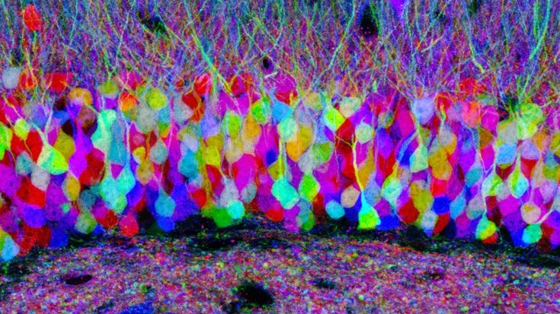
Track module 1 Basics of Image Processing and ML in Python Block 3b
Ekaterina Golubeva
24.10.2022

Slide 2
Plan
Otsu thresholding algorithm
Image convolution
Edge detection operators
List of commands
Non-local means denoising

Slide 3
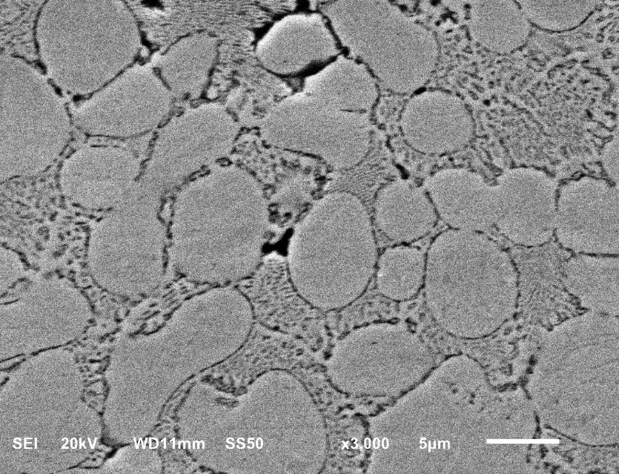
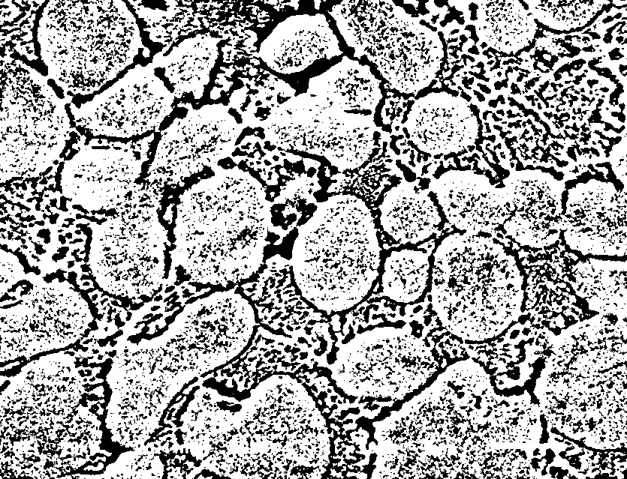
Otsu’s image segmentation/thresholding algorithm

Slide 4
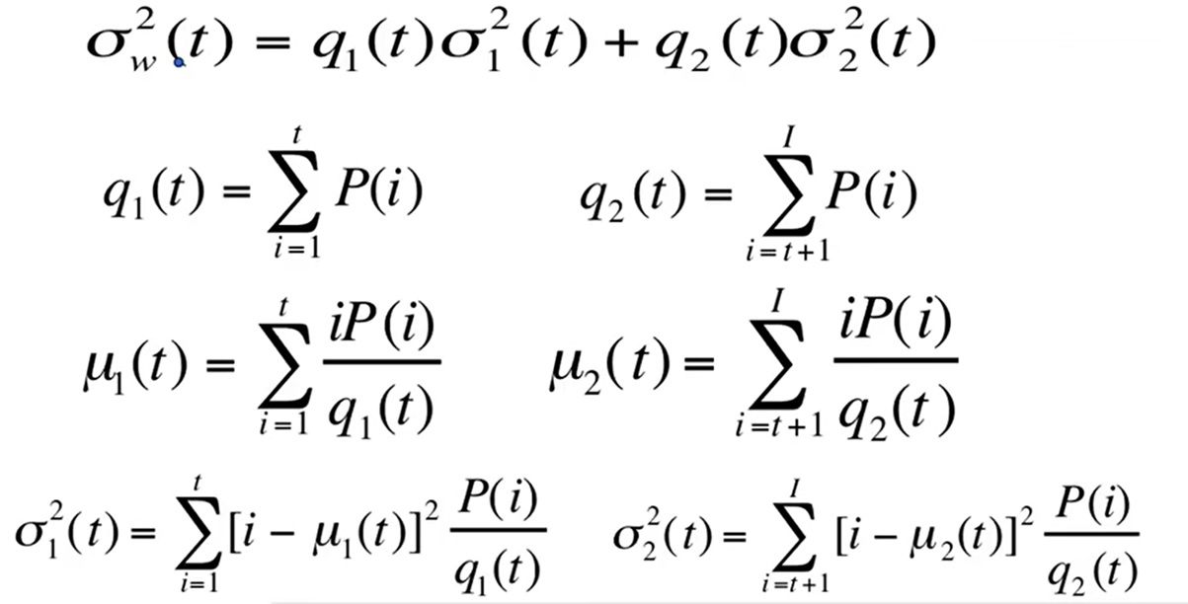
Goal : minimize within class weighted variability

Slide 5
Equivalent : maximize between-class variability

Slide 6
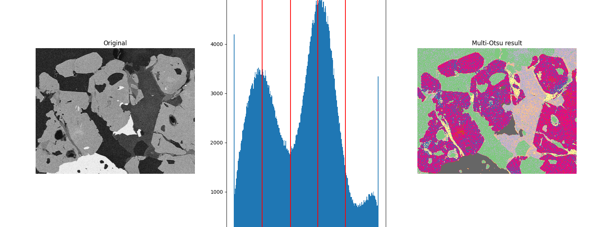
Multithreshold
threshold_multiotsu(image, classes=5)

Slide 7
Image convolution

Slide 8
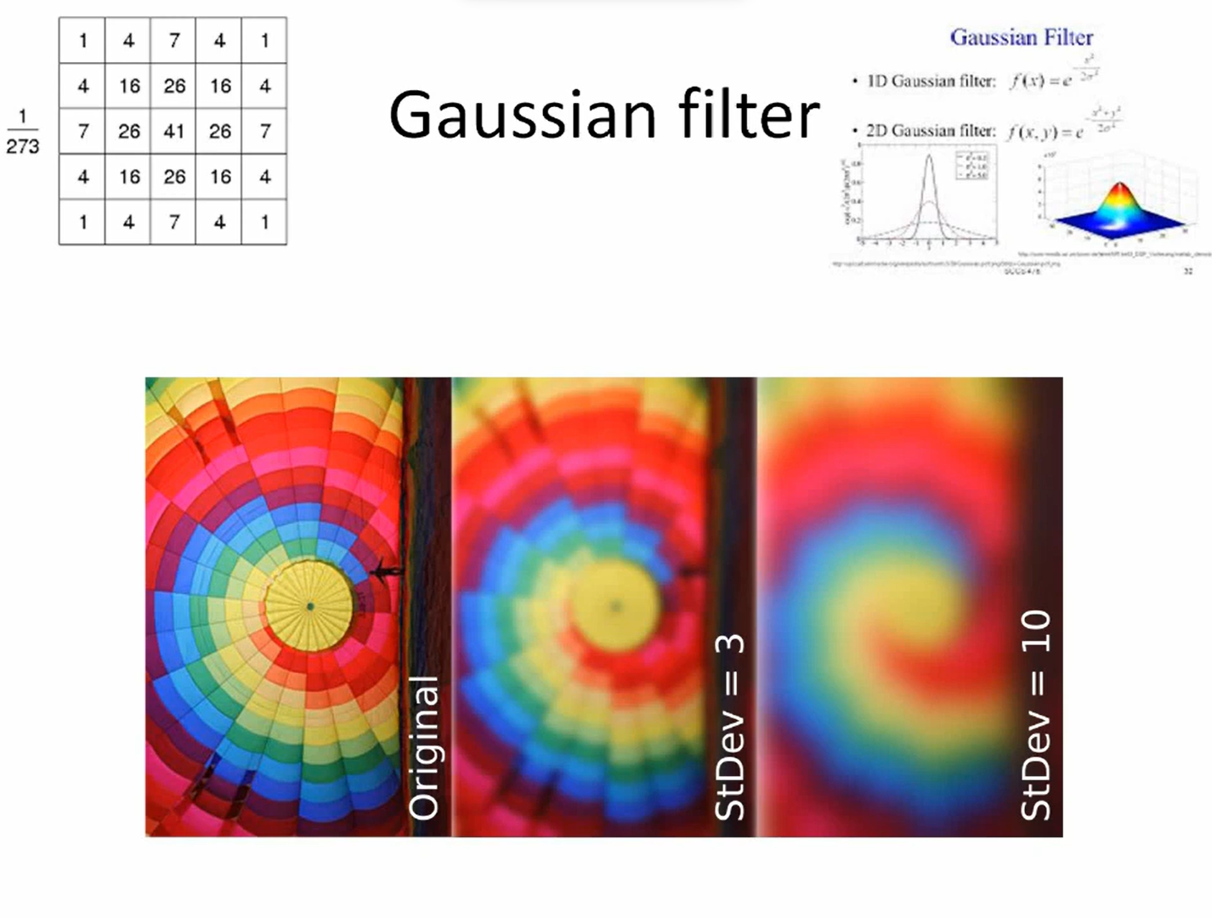

Slide 9
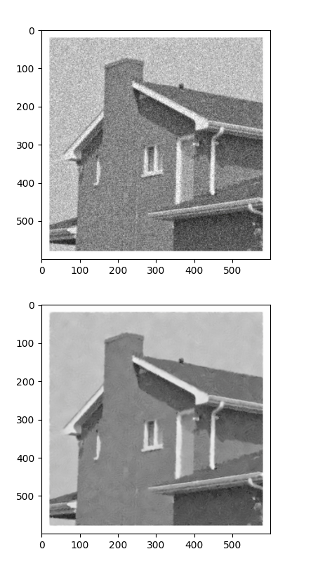
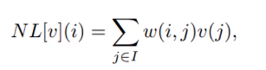
Non-local means denoising
Estimated value is the weighted average of all pixels in the image, but the family of weights depend on the similarity between the pixels I and j, i.e similar pixel neighborhoods give larger weights.

Slide 10
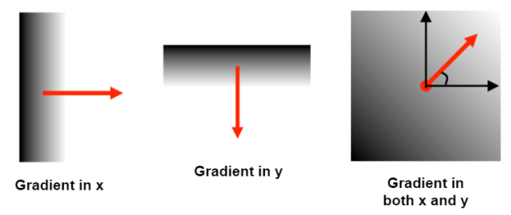
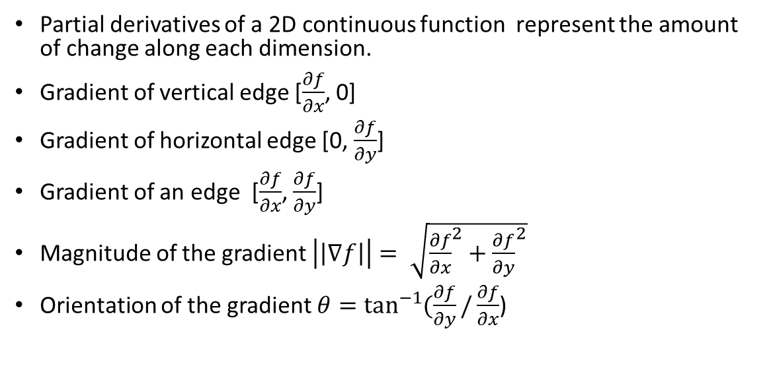
Edge detection : gradient
Partial derivatives of a 2D continuous function represent the amount of change along each dimension.
Gradient of vertical edge [$\frac{∂f}{∂x}$, 0]
Gradient of horizontal edge [0, $\frac{∂f}{∂y}$]
Gradient of an edge [$\frac{∂f}{∂x}$, $\frac{∂f}{∂y}$]
Magnitude of the gradient $\left|\left|∇f\right|\right|= \sqrt{{\frac{∂f}{∂x}}^{2}+{\frac{∂f}{∂y}}^{2}}$
Orientation of the gradient $θ=\tan^{−1}{(\frac{∂f}{∂y}/\frac{∂f}{∂x}}$)

Slide 11
Edge detection approximation
To apply derivatives on images we want to approximate them with finite differences. We use convolution
We convolve the kernels with the image and get all the information about the edges (their strength and orientation)

Slide 12
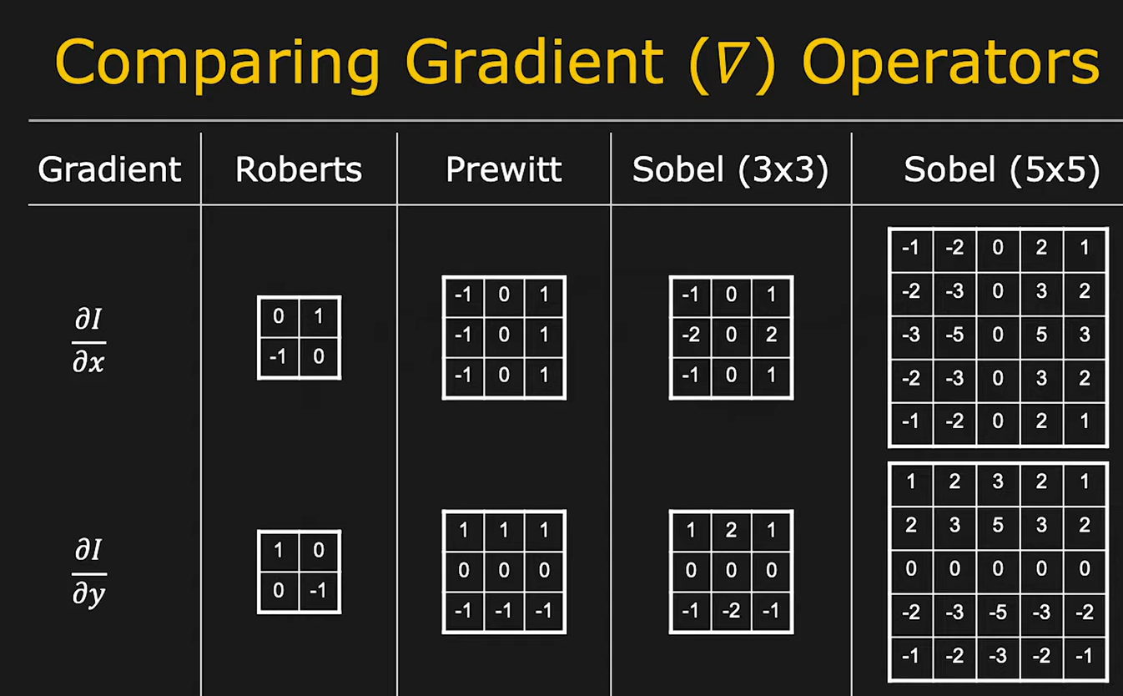
Edge detection: operators and their kernels

Slide 13
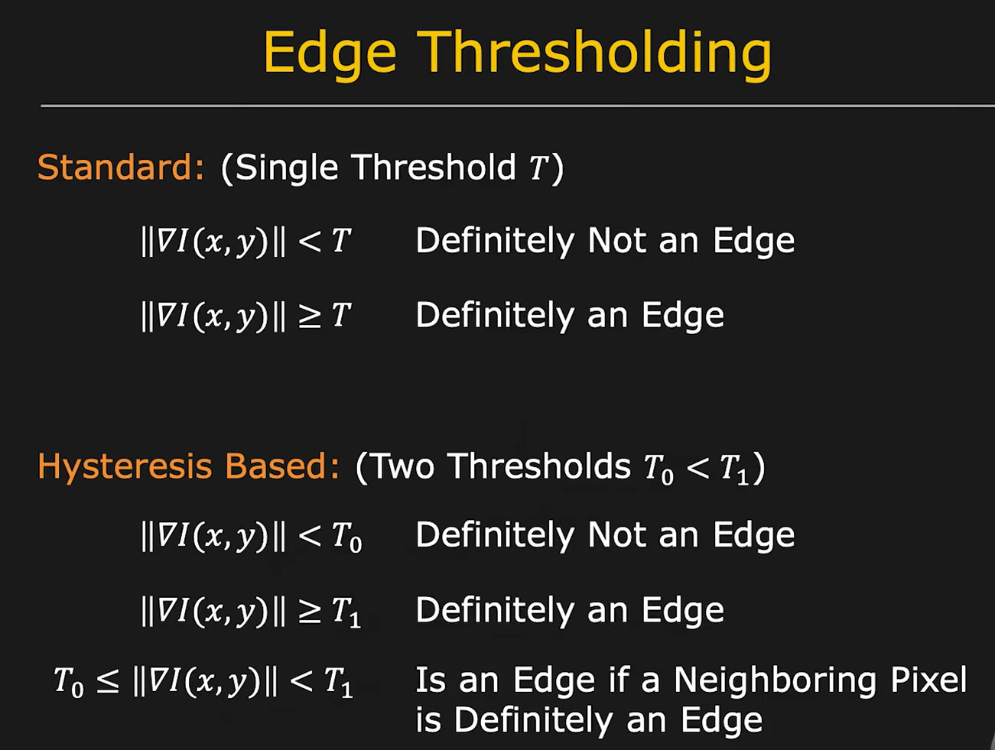
Edge thresholding

Slide 14
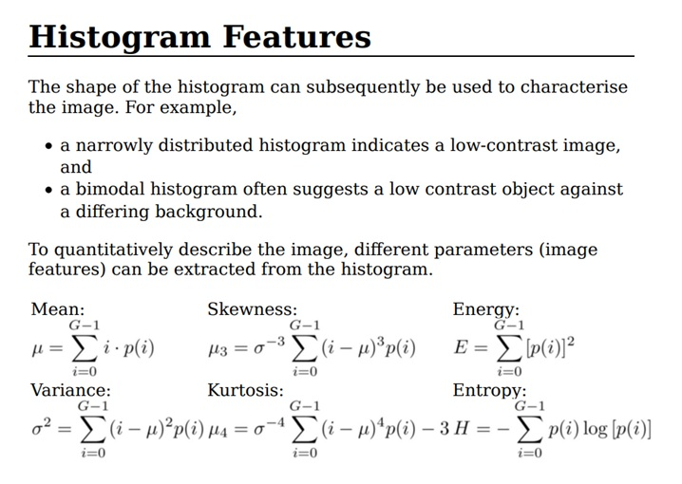
Image characteristics to study further : entropy and histogram equalization

Slide 15
Command | Description | Library
entropy(img, disk(5)) | Entropy | Scikit image, filters, rank
nd.gaussian_filter(img,sigma =3) | Gaussian denoising filter | Scipy, ndimage
nd.median_filter(img,size=3) | Median denoising filter | Scipy, ndimage
blue, green, red = cv2.split(img) | Split color channels | OpenCV
cv2.merge((blue,green,red)) | Merge color channels | OpenCV
cv2.Canny(img,100,200) | Canny edge detector | OpenCV
cv2.equalizeHist(img) | Equilized histogram | OpenCV
clahe = cv2.createCLAHE(clipLimit =2.0, tileGridSize=(8,8)) cl_img = clahe.apply(img) | CLAHE | OpenCV
cv2.threshold(cl_img,129,200,cv2.THRESH_BINARY) | Binary thresholding | OpenCV
Command | Description | Library
cv.fastNlMeansDenoising(image) | Non local means denoising | OpenCV
otsu_threshold, image_result = cv2.threshold( image, 0, 255, cv2.THRESH_BINARY + cv2.THRESH_OTSU,) threshold_otsu(entropy_img) | Otsu thresholding | OpenCV
cv2.GaussianBlur(image, (5, 5), 0) | Gaussian blur denoising | OpenCV
plt.hist(image.flat, bins=100,range=(0,255)) | Histogram of an image | Matplotlib, pyplot
filters.roberts(image) | Roberts edge detecting filter | Scikit-image
filters.sobel(image) | Sobel edge detecting filter | Scikit-image
Filters.prewitt(image) | Prewitt edge detecting filter | Scikit-image

Slide 16
Sources/ Literature
Characteristic analysis of Otsu threshold and its applications, Xiangyang Xu, Shengzhou Xu, Lianghai Jin, Enmin Song
Gaussian filter
https://youtu.be/qHn9mctee1Q
Edge detection using gradients
https://youtu.be/lOEBsQodtEQ

Slide 17
Goal for next week
43. What is Machine Learning?
46. Splitting data into training and testing sets
56. What are features in Machine Learning?
57. How to generate features…?
58. What are Gabor filters?

